Slide 1
Brain samples nomenclature (28 samples)
Samples of the wild type are numbered, and samples with trimmed whiskers have the letters assigned
Wild Type: | Animal #: | Sex: | Hemisphere: |  | Trimmed: | Animal #: | Sex: | Hemisphere:
1 | 4 | F | Left |  | A | 9 | F | Left
2 | 4 | F | Right |  | B | 9 | F | Right
3 | 1 | F | Left |  | C | 7 | F | Left
4 | 1 | F | Right |  | D | 7 | F | Right
5 | 3 | F | Left |  | E | 8 | F | Left
6 | 3 | F | Right |  | F | 8 | F | Right
7 | 30 | F | Left |  | G | 16 | M | Left
8 | 30 | F | Right |  | H | 16 | M | Right
9 | 31 | F | Right |  | I | 24 | M | Left
10 | 31 | F | Left |  | J | 24 | M | Right
11 | 6 | M | Left |  | K | 27 | M | Left
12 | 6 | M | Right |  | L | 27 | M | Right
13 | 5 | M | Left |  | M | 23 | M | Left
14 | 5 | M | Right |  | N | 23 | M | Right

Slide 2
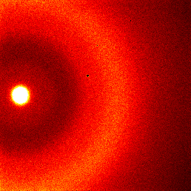
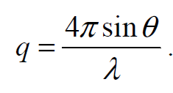
XRD Pattern Overview
Characteristic XRD pattern
28 samples
~20 mm from sample to detector (this is not confirmed)
q – field of view range of apprx 6 - 30
Appear to have circular symmetry
All patterns are normalized by the integral of primary beam
q = 14
q = 10
q = 4.3

Slide 3
Brain samples intensity profiles (28 samples)
Peak 1
Peak 2
Primary
Beam edge
Peak 3
q ~ 4.3
q ~ 10
q ~ 14

Slide 4
Gaussian Fitting - examples
Peak 2
Peak 3
Peak 1

Slide 5
Peak 1
No clear separation between wild type and trimmed

Slide 6
Peak 2
No clear separation between wild type and trimmed

Slide 7
Peak 3
Seems to be a separation between wild type and trimmed

Slide 8
XRD Pattern Overview
q = 14
q = 10
q = 4.3

Slide 9
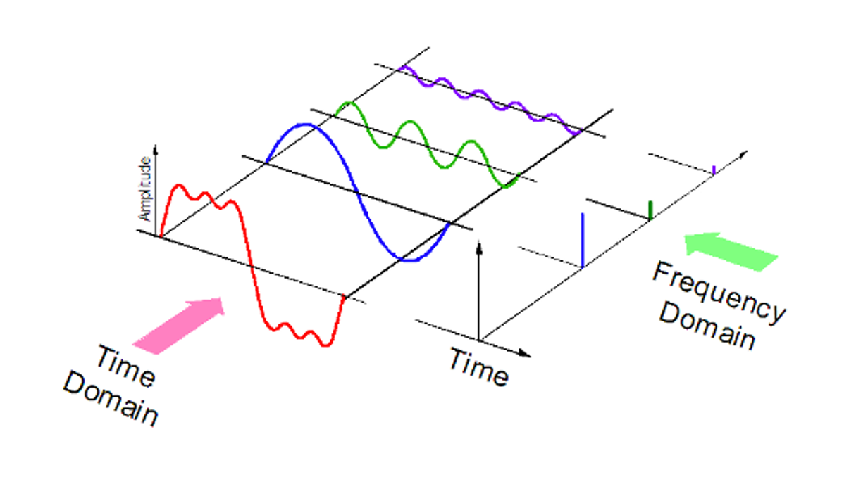
Fourier Analysis

Slide 10
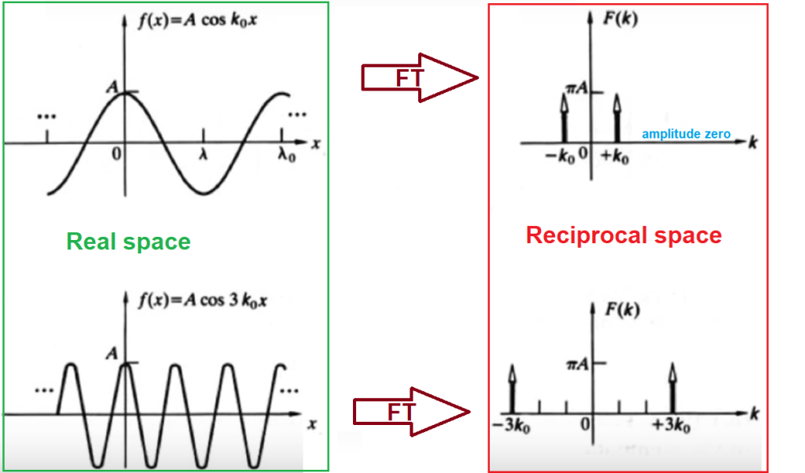
Space Fourier Analysis

Slide 11
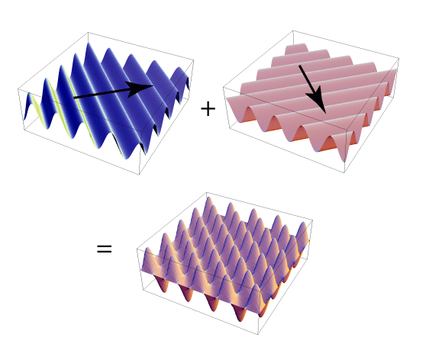
2D Space Fourier Analysis

Slide 12
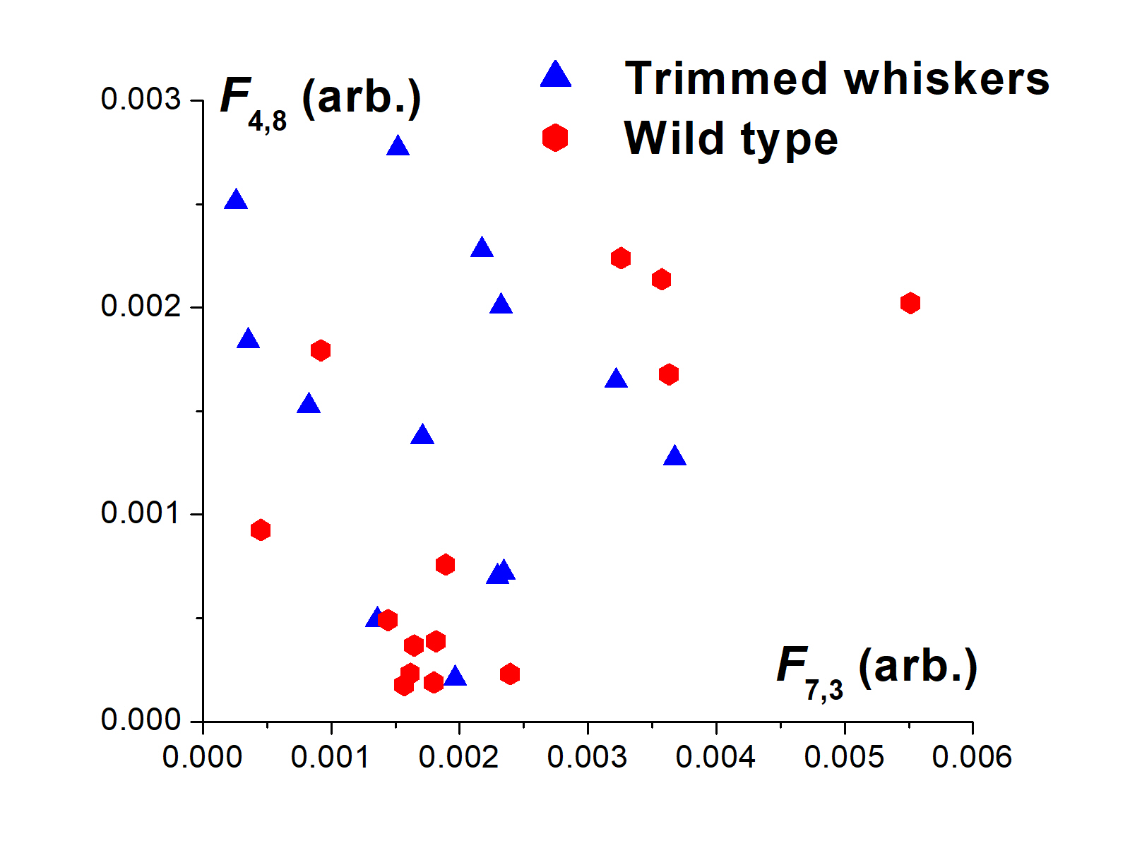
XRD Pattern Overview

